Slide 1
Capstone Project 2 – Analysis of Airbnb listings in Chicago
By Vikram Singh

Slide 2
Introduction
The data in this project contains information for Airbnb listings from December 23rd 2013 to July 11th 2017 and is restricted to listings in Chicago
The features of this dataset include the following:
Accommodates: The number of guests a listing can accommodate
Bathrooms: The number of bathrooms a listing offers
Bedrooms: The number of bedrooms a listing offers
Borough: A subregion of the city or search area for which the survey is carried out. The borough is taken from a shapefile of the city that is obtained independently of the Airbnb website. For many cities, there is no borough information.
City: The city in which a listing is located
Host_id: Unique identifier given to each host on Airbnb’s website
Last_modified: Date/Time which values were read from the Airbnb website
Latitude: The latitude for a listing as posted on the Airbnb website
Location: The location of a listing as posted on the Airbnb website

Slide 3
Introduction (continued…)
The features of this dataset include the following:
Longitude: The longitude for a listing as posted on the Airbnb website
Minstay: The minimum number of nights required for booking a listing, as posted by the host.
Neighborhood: The neighborhood in which a listing is located
Overall_satisfaction: Average rating out of 5 that the listing has received from those visitors who left a review
Price: The nightly cost in $US for a listing
Reviews: The number of reviews a particular listing has received
Room_id: Unique identifier given to each listing
Room_type: The category to which the listing most closely belongs. Can be ‘Private Room’, ‘Entire home/apt’, or ‘Shared Room’.
Survey_id: Unique identifier given to each instance of the survey given to a customer following their visit at a listing.

Slide 4
Data Cleaning
The data was provided in 26 separate .csv files, so I had to format the data into a format with which I could work with properly.
Using pandas, I read each file in and appended them to one another into one large dataframe.
Irrelevant features such as “Borough”, “City” and “Country” were removed

Slide 5
Data Cleaning (Missing Values)
Missing values for “Accommodates” and “Bedrooms” were filled in with integer closest to mean value
The “Minstay” feature had roughly 60,000 missing values, and these were filled in with a value of 1 because that is the minimum possible stay
“Overall Satisfaction” also had missing values, and were filled with a value of 4.
This was done to mimic the average value of the column before cleaning
Since the data represented the overall satisfaction of a listing as the average of its satisfaction rating, I kept this consistent and filled the NA’s with a value of 4, which is very close to the existing mean of 4.019

Slide 6
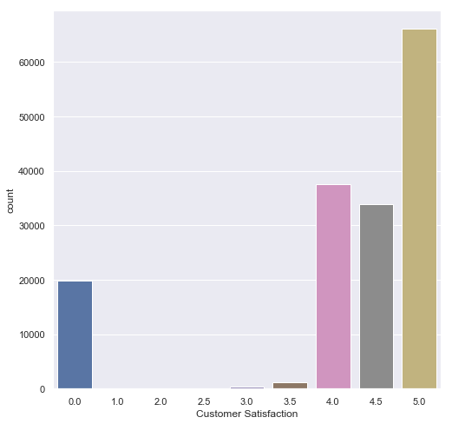
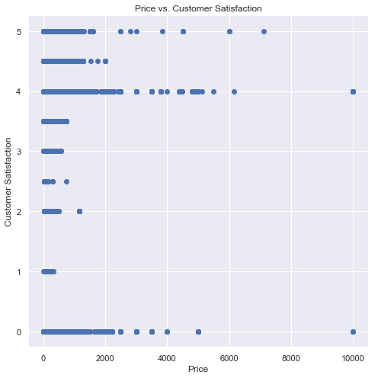
Exploratory Data Analysis
Overall satisfaction countplot shows high polarity in the data
41.5% of data has 5*, followed by 4* with 23.6%
Overall satisfaction countplot shows high polarity in the data
Price distribution is highly right skewed
48.6% of listings cost less than $100/night
97% of listings cost less than $500/night

Slide 7
Exploratory Data Analysis (Reviews)
To gain further insight, I divided the data into partitions based on the “Room Type” variable
I then decided to see how the satisfaction rating would differ based on the number of reviews a listing had
Although there are differences in frequency, it is apparent that listings which are more highly reviewed receive a higher customer satisfaction rating across the board
The mean for listings with more than 10 reviews vs less than 10 is over 1.0 in each case.
 | Count | Mean # of Reviews | % of listings with 10 or less reviews | Mean Rating with more than 10 reviews | Mean Rating with 10 or less reviews
Private Room | 58045 | 19.3 | 39.3% | 4.8 | 3.58
Shared Room | 6157 | 12 | 43.8% | 4.62 | 3.57
Entire House/Apt | 94969 | 16.3 | 43% | 4.76 | 3.75

Slide 8
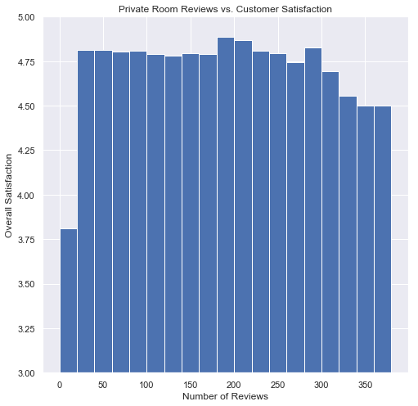
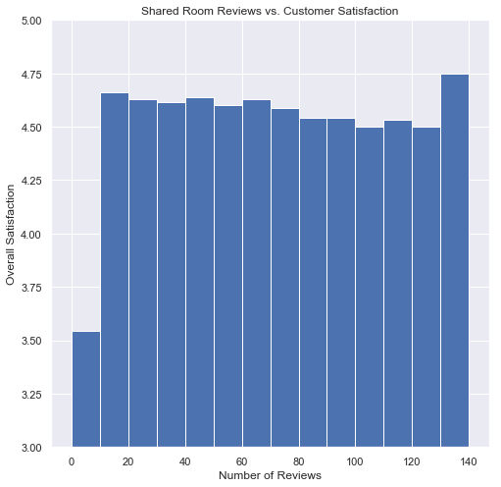
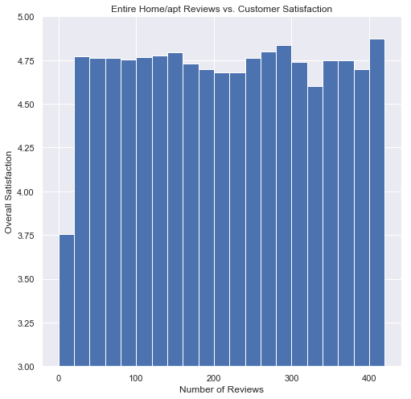
Exploratory Data Analysis (Reviews)

Slide 9
Exploratory Data Analysis (Price)
Price distribution is slightly right skewed (Majority of listings are priced lower than the mean)
Listings receive more 5* ratings generally when priced below the mean
Implies that listings which may be priced higher due to being of “higher quality” are not as well received by the customer in most cases
Private room’s priced below the mean have the highest average overall rating at 4.11
 | Mean Price | % of listings priced above the mean | % of listings priced below the mean | Average rating for listings priced above the mean | Average rating for listings priced below the mean | % of 5* ratings for listings priced above the mean | % of 5* ratings for listings priced below the mean
Private Room | $78.78 | 33.6% | 66.4% | 4.01 | 4.11 | 15.2% | 29.1%
Shared Room | $57.95 | 30.2% | 69.8% | 3.63 | 4.01 | 8.59% | 18.9%
Entire house/apt | $194.28 | 30.6% | 69.4% | 3.73 | 4.08 | 11.32% | 29.3%

Slide 10
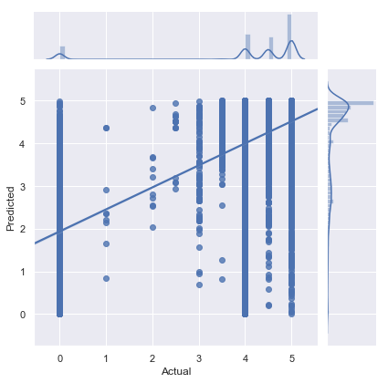
Machine Learning (Regression)
Random Forest Regression graph is depicted on the right with density distribution and fitted residual line, to predict satisfaction rating
Correlation coefficient (R) value of 0.689
5* ratings are more accurately predicted using the model due to lower MSE and higher density of values being present in the 5* range of both the actual and predicted values
The issue with this model, is the inability to accurately predict 0* ratings
This is mainly due to high intercept of the model being almost 2, causing a high MSE
I believe this issue is mainly due to the polarity present in the data

Slide 11
Machine Learning (Classification)
Logistic Regression Classification report is displayed on the right, to predict if a listing would receive a 5* rating
Similar precision, but much lower recall for True predictions
Many of the underlying True predictions aren’t being captured by the model despite the 61% precision
 | Precision | Recall | F1-Score | Support (Count)
False | 0.61 | 0.91 | 0.73 | 23139
True | 0.61 | 0.20 | 0.30 | 16657
avg/total | 0.61 | 0.61 | 0.55 | 39796

Slide 12
Machine Learning (Classification)
Random Forest Classifier Classification Report is displayed on the right, to predict if a listing would receive a 5* rating
Much higher precision and recall
Model is still better at predicting False values, but the difference is less apparent
With this new model, I decided to look at the relative feature importance
Surprisingly, “Reviews” have a higher importance than “Price”
 | Precision | Recall | F1-Score | Support (Count)
False | 0.61 | 0.91 | 0.73 | 23139
True | 0.61 | 0.20 | 0.30 | 16657
avg/total | 0.61 | 0.61 | 0.55 | 39796
Feature | Importance
Reviews | 0.5951
Price | 0.329
Accommodates | 0.0493
Bedrooms | 0.0196
Shared Room | 0.0033
Private Room | 0.00195
Entire home/apt | 0.00153

Slide 13
Recommendations
The listings I have examined in this Capstone reflect the observable trends and insights which can be made by observing Airbnb listings in the city of Chicago. It is possible that insights in this project apply in many cities, treating each individual location as independent is important due to the differences between cities and countries. This project represents one example where findings could potentially be aggregated with others after applying a case by case analysis.
The number of reviews is the single most important factor in determining customer satisfaction rating
Listings with more reviews will get higher ratings
This could possibly be due to the influence of others when providing input on something which has already received a lot of feedback
This emphasizes the importance to a host of receiving more reviews, and emphasizing that their first few reviews are positive experiences to their customers
This could provide reason for Airbnb to offer incentives to customers to leave a review, and gain even more data which can be used for long term analysis

Slide 14
Recommendations
There are only minor differences between the type of room being offered, and the most well received listings are priced below the mean
EDA did reveal slight differences between overall satisfaction between the three different room types, however the feature importance of these variables are relatively small
Price is the second most important variable with respect to customer satisfaction
Overpriced listings usually perform poorly with the customer, and could be justification for analysis of listings which are placed above a certain threshold to ensure a better customer experience

